Slide 1
Computer Networks 2025-2026 Exercises: Introduction
Johan Bergs – Andrei Belogaev
johan.bergs@uantwerpen.be – andrei.belogaev@uantwerpen.be

Slide 2
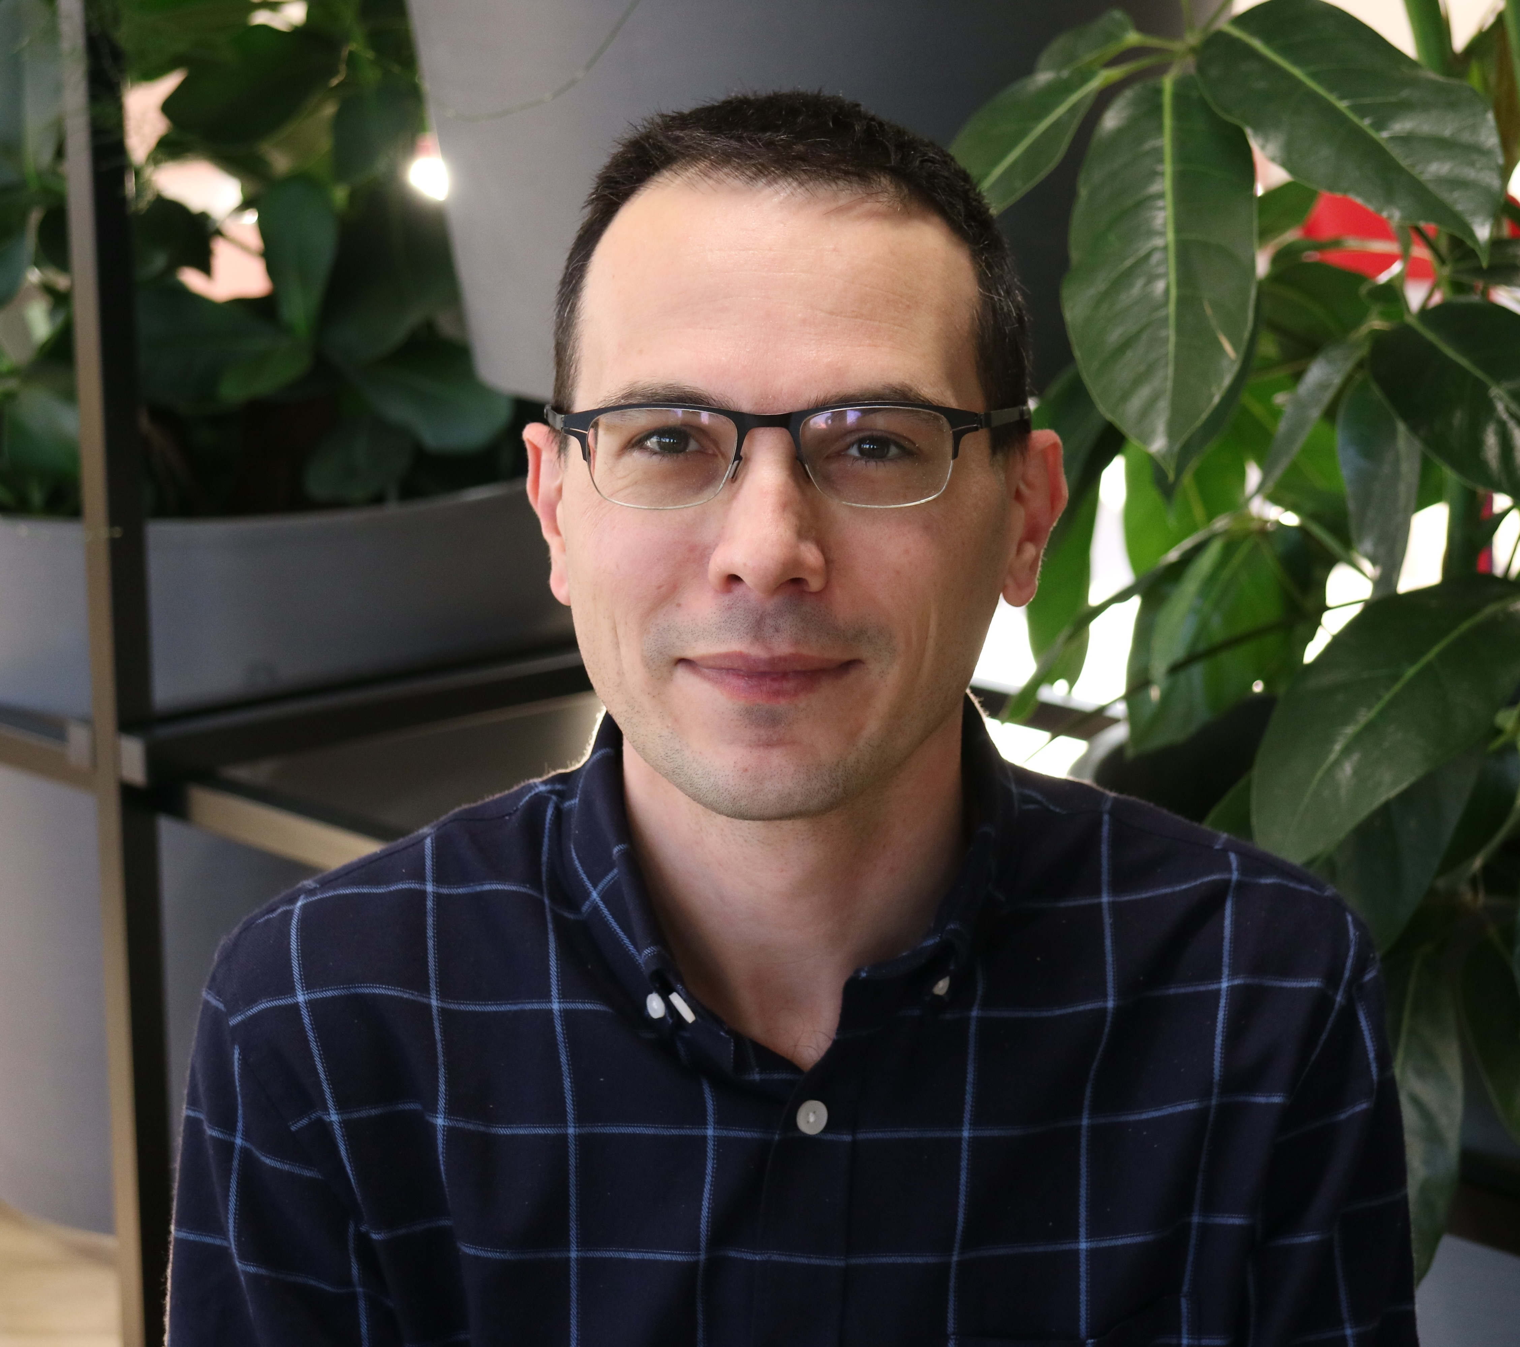
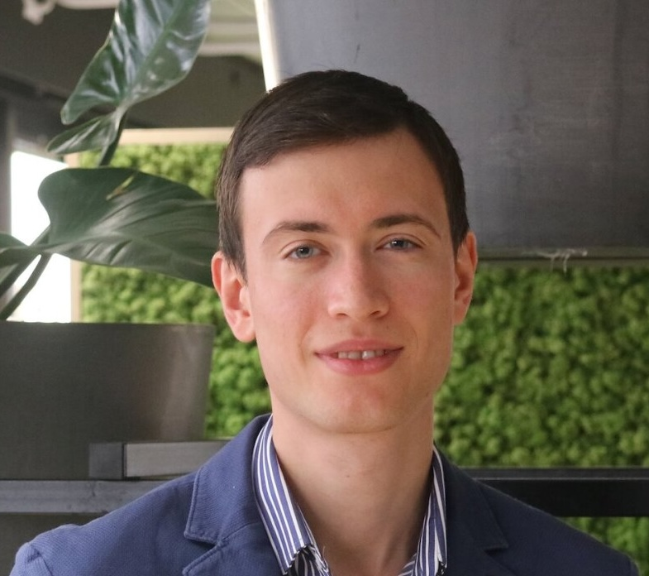
Who are we?
Johan Bergs
Andrei Belogaev

Slide 3
Practical Arrangements
The exercises are made in groups of 2
Groups should be formed on Blackboard by the 27th of February at the latest
Exception: the exercises of today
The exercises are divided in several “labs”
At the start of each lab, you will get the lab assignment
Most lab sessions are divided over two weeks
At the end of each lab session, a report needs to be handed in on Blackboard
During the lab sessions on Fridays:
Frequent mistakes in previous sessions are explained
Additional information is given to accompany the lab assignments
We are present to answer any questions

Slide 4
Communication
Important messages
All important messages will be posted on Blackboard.
Questions
We are available for questions during the weekly classes on Friday
As both Johan and Andrei have their office at the Beacon (CST), and not at CMI, the best way to contact them is via e-mail. Always send a mail to both!
When stuck:
(Double)-check if you are following the instructions in the exercise correctly
(Double)-check the theory
Ask your fellow students
Ask Johan or Andrei

Slide 5
Grading
Lab sessions
Lab sessions have deadlines. A missed deadline means no grades for that lab!
Lab sessions that are handed in, will be corrected as soon as possible.
Grades for each lab session will be made available on Blackboard.
Both of the group members receive the same grades.
Final grade
The final grade for the exercises is a weighted average – not every lab receives the same weight.
The grades for the exercises make up 50% of the grades for the course.
No separate ”lab exam” – the labs are permanently evaluated throught the semester.
In order to pass:
You need to obtain at least 10/20 in total, and
You need to obtain at least 4/10 on both theory and labs.
If you should fail only 1 part, the grades for the other part can be transferred to the re-examination.

Slide 6
Lab weights & Deadlines
Weights
Deadlines
Lab name | Weight
Lab 1 | 5.0%
Lab 2 | 20.0%
Lab 3 | 22.5%
Lab 4 | 22.5%
Lab 5 | 22.5%
Lab 6 | 7.5%
When? | What?
Thursday 26/2 23:59 | Lab 0
Thursday 12/3 23:59 | Lab 1
Thursday 26/3 23:59 | Lab 2
Thursday 23/4 23:59 | Lab 3
Thursday 7/5 23:59 | Lab 4
Wednesday 20/5 23:59 | Lab 5
Monday 25/5 23:59 | Lab 6

Slide 7
Schedule
When? | What?
Friday 13/2 | Lab 0 – Introduction
Friday 20/2 | No lab session
Friday 27/2 | Lab 1 – Application Layer + deadline lab 0
Friday 6/3 | Lab 1 (cont.)
Friday 13/3 | Lab 2 – Transport Layer + deadline lab 1
Friday 20/3 | Lab 2 (cont.)
Friday 27/3 | Lab 3 - Network Layer I (IPv4 and IPv6) + deadline lab 2
Friday 3/4 | Lab 3 (cont.) + Lab 4 – Network Layer II (routing)
Friday 10/4 | Easter holiday
Friday 17/4 | Easter holiday
Friday 24/4 | Lab 4 (cont.) + deadline lab 3
Friday 1/5 | No lab session (university closed)
Friday 8/5 | Lab 5 – Link Layer + deadline lab 4
Friday 15/5 | No lab session (university closed)
Th 21/5 + Fr 22/5 | Lab 6 – Link layer II + deadline lab 5

Slide 8
Let’s start with Lab 0!

